Slide 1
Java Basics
First appeared in 1995, initially developed by James Gosling at Sun Microsystems (now acquired by Oracle)
Java is a programming language and a platform. Java is a high level, robust, object-oriented and secure programming language.
Any hardware or software environment in which a program runs, is known as a platform. Since Java has a runtime environment (JRE) and API (Application Programming Interface), it is called a platform.
API is interface between different programs to exchange data.

Slide 2
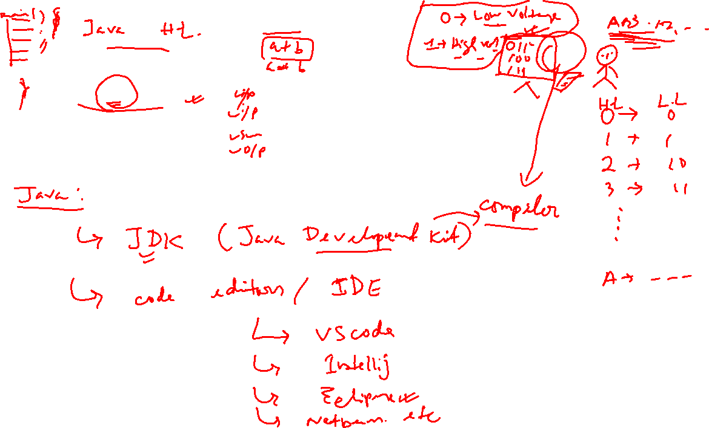
How Code works?

Slide 3
How to instal JDK and Eclipse
To check already java is installed in your computer or not
On cmd type java –version
If not then, type on browser java jdk download
Download the latest JDK 17 and install
Go to the program files in C (installation location), copy the path
In system environment variables, in systems click on path, the new then paste the copied path. Press ok
Check again whether java is installed or not by again going to cmd, type java –version
Now again go to browser, type download eclipse and download the latest version

Slide 4
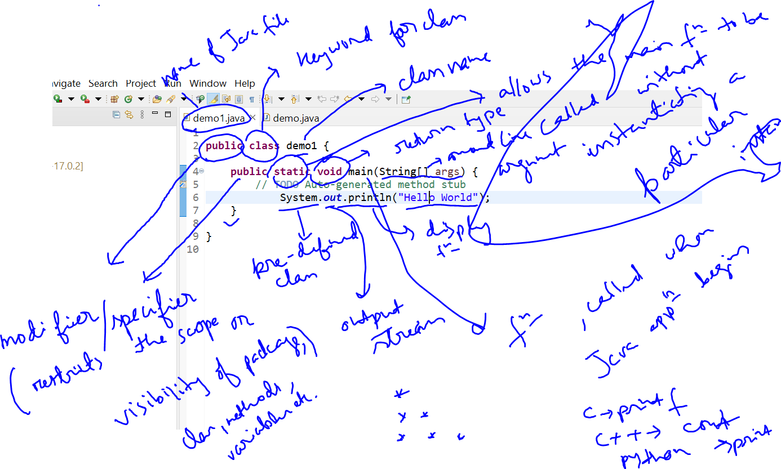

Slide 5
